Slide 1
Why did Italy invade Abyssinia?
L/O: To state how Mussolini invaded Abyssinia 1935-1936
Challenge: Assess Mussolini’s reasons for the invasion
Key words, terms and individuals: Fascist, Stresa Front and Haile Selassie
SMSC: Moral

Slide 2
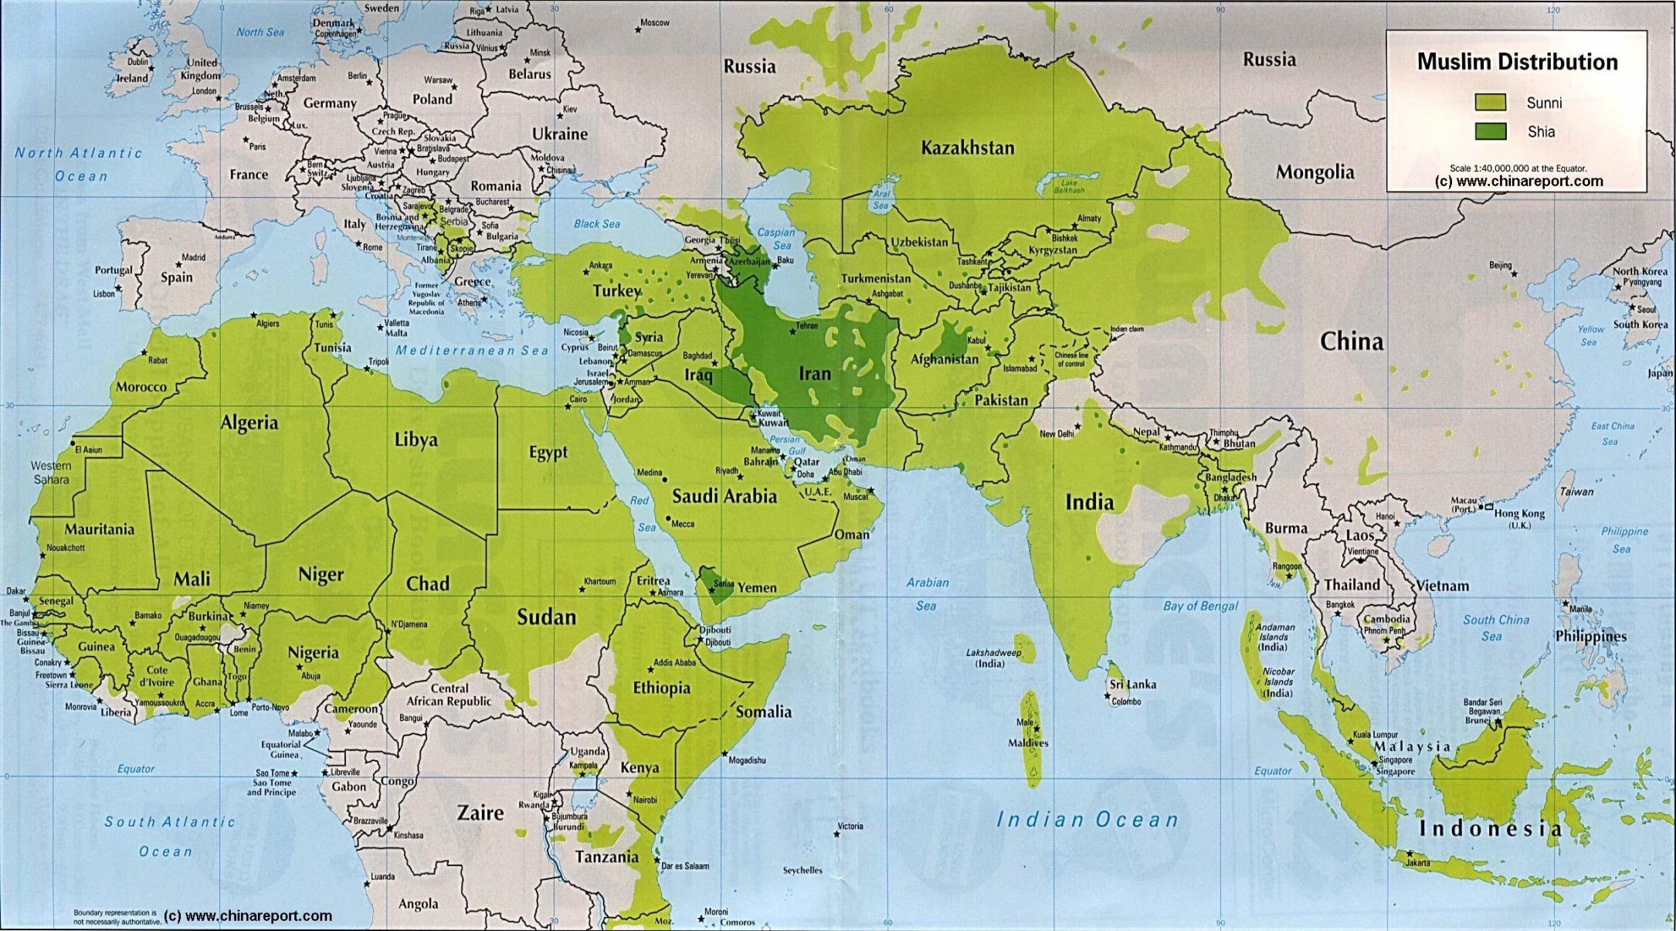
Abyssinia: where is the world are we talking about in this lesson?
You are here…

Slide 3
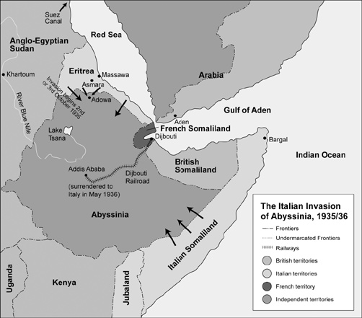
Zooming in on the area…

Slide 4

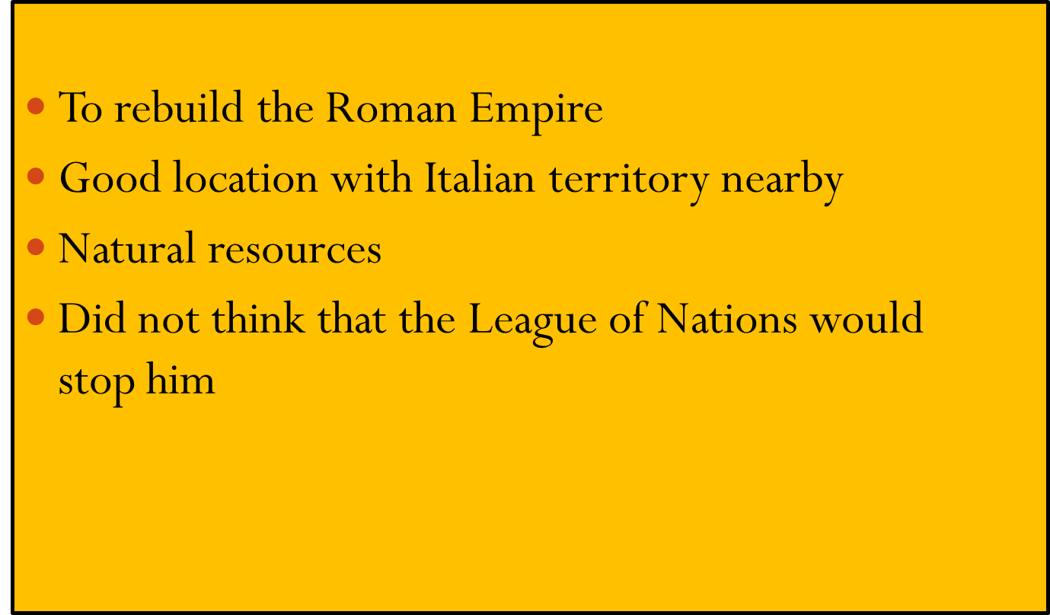

Slide 5

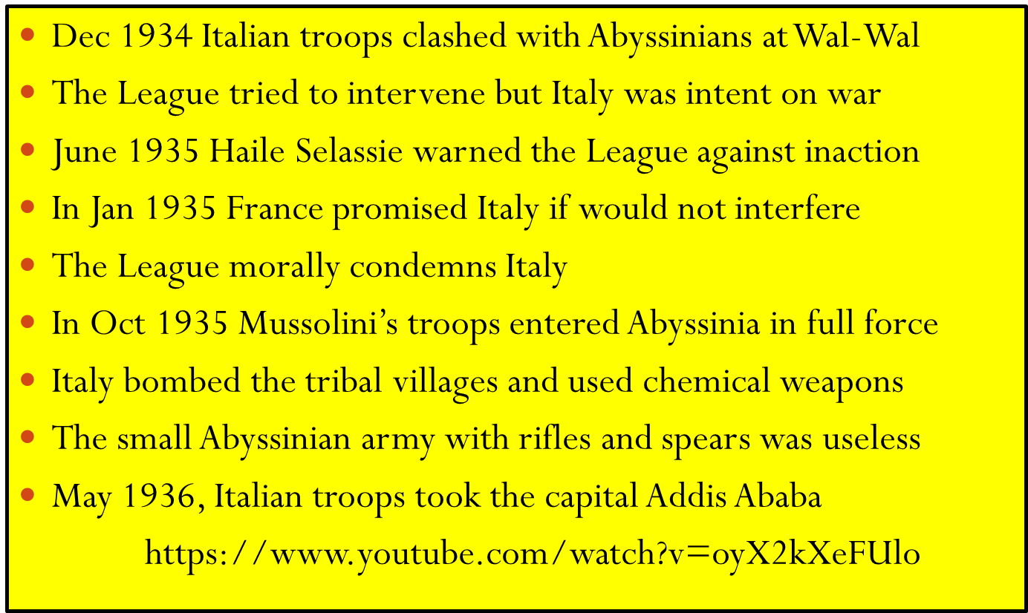


Slide 6
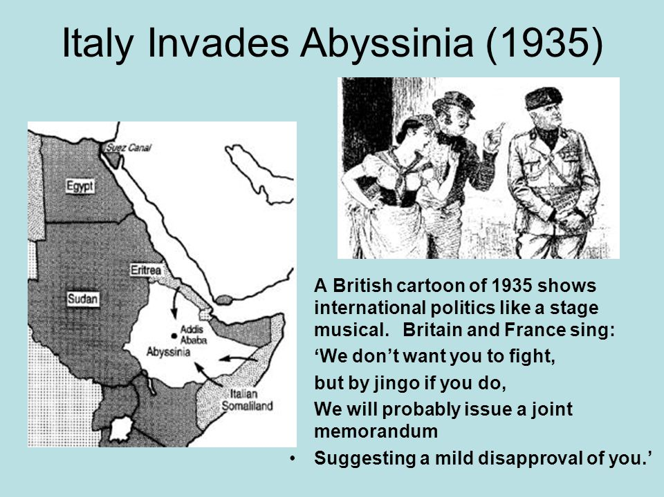

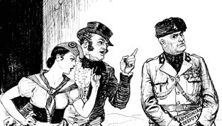
Sources:

Slide 7

Write an account of how Mussolini’s invasion of Abyssinia led to Ital leaving the League
Make reference to events in chronological order
(do not JUST tell the story)
Point out the causes
Discuss the consequences
Try to write 20 lines in 10 minutes

